Slide 1
Presented by – Ayush Bhardwaj
Unlocking the Power of Econometrics: OLS, 2SLS, and Logistic Regression
Created on – March 6th 2023

Slide 2
Econometrics
Ordinary Least Squares (OLS)
Two-Stage Least Squares (2SLS)
Logistic Regression

Slide 3
What is Econometrics
Econometrics is the application of statistical methods in economics.
Its deals with regression analysis a lot of the time.
Regression is the relationship between one ore several independent variables and the expected value of the corresponding dependent variable.
It helps with testing economic theories and hypothesis.
Helps with forecasting economic variables.

Slide 4
Types of economic data
There is mainly three main types of economic data:
Time Series
Time series is observation over time
Example:
GDP measured for 10 years in one specific country.
Cross-Sectional
Cross sectional is observation across subject.
Example:
Annual GDP of certain set of countries in specific year.
Panel Data
It is observation over time and subject.
Example:
Annual GDP of certain set of countries between a set of years

Slide 5
Simple linear regression (slr)
We find a liner function of dependent and independent variable.
We try to find linear line that represent the relationship between y and x, where y is dependent and x is independent.
Standard form for linear line is:
ŷ = b0 + b1x + u
Where:
ŷ – dependent variable
x – independent variable
b0 – y intercept
b1 – slope of line
u - error

Slide 6
R squared
In R squared we look at the distance.
Determining the distance between the regression line estimated values and the actual values.
The process of taking the actual values and the distance to the mean, distance for actual value, and then comparing this to he estimated values determine by the regression line and comparing that to the distance estimated to the mean and comparing those two.
Formula:
R2 = ∑(ŷ - y̅)2 / ∑(y - y̅)2

Slide 7
Standard error of the estimate (mean square error)
Comparison of estimated values to the actual values.
Calculating distance of estimated and the actual values.
This distance are called Error (represented by e, r or u).
Standard Error of the Estimate = sqrt{∑(ŷ - y)2/n-2}

Slide 8
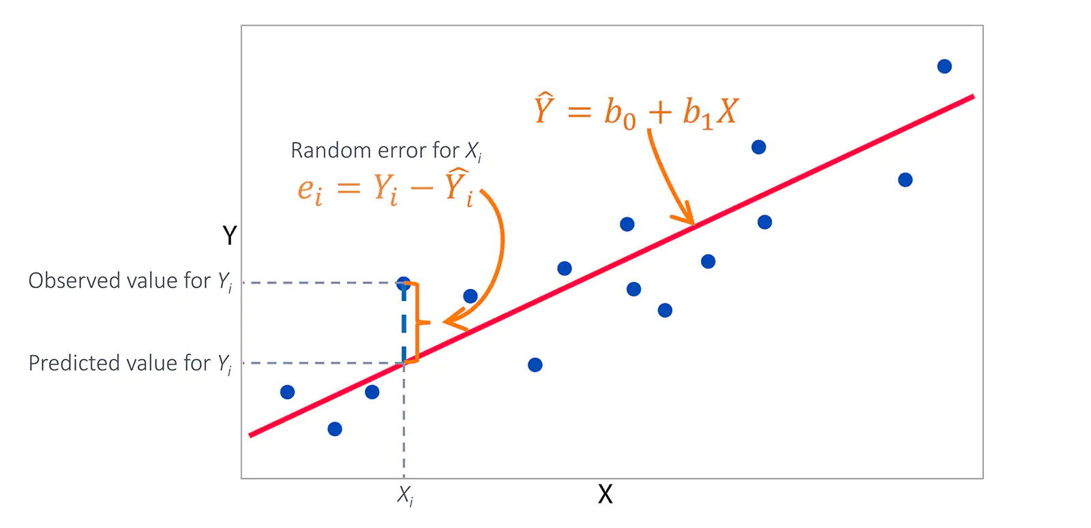
Ordinary least squares method (ols)
The idea of OLS is, to find the regression line which minimizes the distances of the actual values to the line.
Statistical technique used to estimate the parameters of a linear regression model.
It involves minimizing the sum of the squared differences between the predicted values of the dependent variable and the actual values.
The equation takes the form:
y = b0 + b1x1 + b2x2 + ... + bn*xn + e

Slide 9
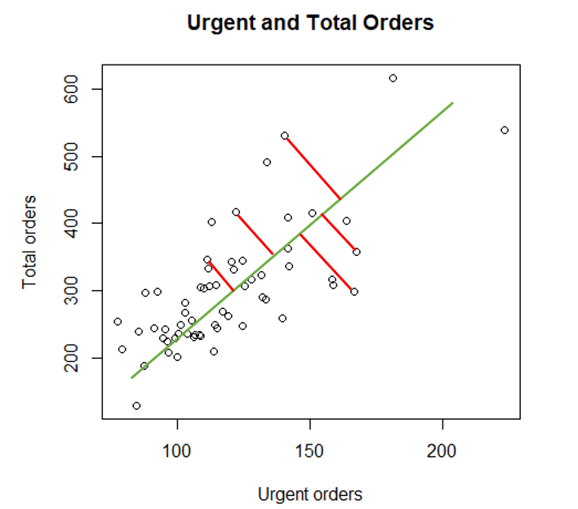
Using OLS for Regression Analysis
Ordinary Least Squares (OLS) is a statistical technique used to estimate the parameters of a linear regression model, allowing us to forecast how independent variables will interact with a dependent variable.
OLS is a powerful tool for predicting the effect of one or more independent variables on a dependent variable. It can also be used to predict how different independent factors will affect a single dependent variable.

Slide 10
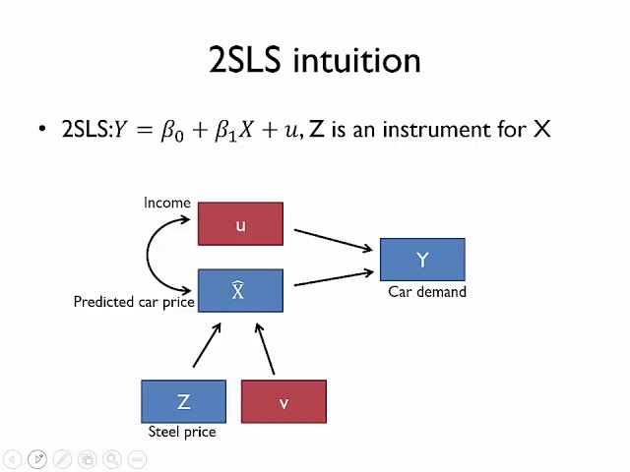
Two Stage least method (2sls)
2SLS is a statistical method used in econometrics to address endogeneity issues in linear regression models.
Endogeneity occurs when one or more of the explanatory variables are correlated with the error term in the regression model, leading to biased and inconsistent estimates of the model parameters.
The 2SLS method involves two stages.
Stage 1:
instrumental variables (IVs) are used to estimate the endogenous explanatory variables. IVs are variables that are correlated with the endogenous variable of interest, but are not correlated with the error term.
Stage 2:
the predicted values of the endogenous explanatory variables from the first stage are used in the regression analysis. This eliminates the correlation between the endogenous variable and the error term, resulting in consistent and unbiased estimates of the model parameters.

Slide 11

How and When to Use 2SLS
2SLS is an extension of ordinary least squares (OLS) used to estimate linear regression models with endogenous independent variables.
This technique is used when the independent variables are correlated with the error term and can be used to forecast the relationship between a dependent variable and one or more independent variables.

Slide 12
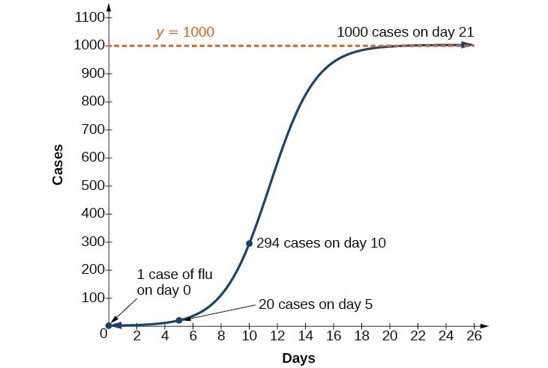
Logistic Regression
A logistic regression model's parameters are estimated using the statistical technique of logistic regression. The likelihood of a binary outcome can be predicted using one or more independent variables. The parameters that optimize the likelihood of the observed data are found through logistic regression.
The probability of a binary result depending on one or more independent variables can be predicted using logistic regression. Moreover, it can be used to forecast the likelihood of several binary outcomes depending on one or more independent variables.
This Photo by Unknown Author is licensed under CC BY

Slide 13
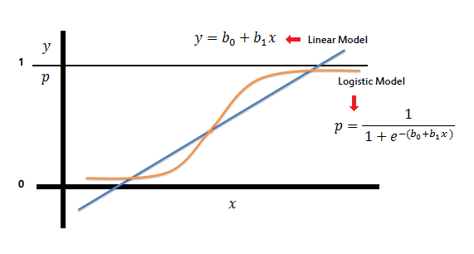
How and When to Use Logistic Regression
Logistic regression is a powerful tool for modeling binary outcomes and can be used to predict the likelihood of a binary result based on one or more independent variables.
The parameters that optimize the likelihood of the observed data are found through logistic regression, and it can also be used to forecast the likelihood of several binary outcomes depending on one or more independent variables.

Slide 14
THANK YOU
I hope that you have enjoyed learning about Econometrics and about OLS, 2SLS, and logistic regression and its uses in econometrics.
Thank you for watching my presentation!

